Slide 1
Subsidiary ICT for Uganda
Curriculum Topic 14 out of 15: DATABASES
Recommended Coverage Duration: 32 periods (5 ¹/₃ weeks)
Senior Six Term II
Notes:
Guidance to the Teacher
You are advised to use the Ms Access or any other database management system that uses a GUI. No knowledge of sql commands is expected.
Using demonstration, guide the learners to take note of the procedures of creating and saving a relational database.
Group the learners or give them individual activities to enable them develop hands-on skills to create databases with appropriate relations, identify features of database development software and their uses.
Demonstrate to the learners the process of adding fields, field names, and specifying data types for a database.
Assess the learners’ correct use of database terms, create and query databases to form reports.
Where possible, prepare a project activity for learners to keep adding on to their skills as they progress with the topic.
Suggested Competences for Assessment
Assess the learners’ ability to create and query the database using a low end database management system.

Slide 2
Background
Think of an address book you might buy in a bookshop. In it, you will write all your important contacts; friends, family, relatives, companies, and other people in your circles.
The address book contains all names, addresses, location, phone numbers of whoever you need to contact at any time.
The world generates an enormous amount of data from almost every aspect of life; school records, credit cards, store merchandise, telephone systems and web sites, among others.
Some time ago, manual effort was used to track and report this information.

Slide 3

Background
Today, database management systems manage this information.
Learning Outcome: The learner should be able to create and query a simple database.

Slide 4
Presentation Outline
UACE Sub – ICT Topic 14:
Databases
Sub Topic 14.1: Introduction to Databases
Sub Topic 14.2: Database Objects
Sub Topic 14.3: (Practical Project) Creating a Complete School Database

Slide 5
Sub Topic 14.1: Introduction to Databases
Sub topic Objectives:
14.1.1 Meaning of a database
14.1.2 Examples of Database Management Systems
14.1.3 Features of Database Management System interface
14.1.4 Creating and saving a database

Slide 6
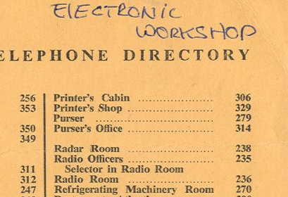
14.1.1 Meaning of a database
A database is structured collection of logically related data that is stored so that it can easily be accessed / retrieved.
Logically related data comprises entities, attributes, and relationships of an organization’s information.
Examples of databases include:
Phone Address Book
Business Customer Lists
Club Membership Lists
Company’s Employee Database.
The library database
Video Library, etc.

Slide 7
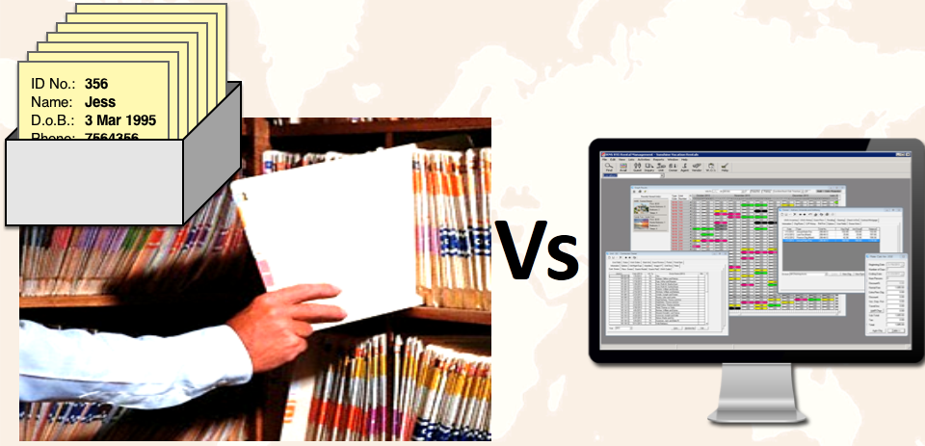
14.1.1 Meaning of a database
Electronic Vs Manual Databases
A manual database is one that is not computerised – i.e. not available in electronic format. A telephone directory, an organiser or printed address book are examples of manual databases.
An electronic database is one that is computerised, and can be accessed/manipulated using computer applications.

Slide 8
14.1.1 Meaning of a database
Advantages of Electronic Databases over Manual databases
Electronic databases store very large amounts of data
Electronic databases allow easy input and editing of data
Electronic databases enable automatic updating and recalculating of data
Electronic databases make it easier to query, search, filter and retrieve required data.
Electronic databases format, arrange and present information in customizable ways

Slide 9
14.1.1 Meaning of a database
Advantages of Electronic Databases over Manual databases
Electronic databases can easily share the information with other software applications/programs
Electronic databases allow centralised use of information amongst many users over a network and therefore reduce duplication, e.g in banks.
Data is validated before it is entered in electronic databases. Errors created during data entry are minimized
Many built-in functions are available to in Electronic databases simplify calculations.

Slide 10
14.1.1 Meaning of a database
Disadvantages of relying on electronic databases as compared to manual databases.
Complexity: The provision of the functionality we expect of a good database makes it complex to set up. Database designers, database administrators, and end-users must understand this functionality to take full advantage of it. Failure to understand the system can lead to bad design decisions, which can have serious consequences for an organization.

Slide 11
14.1.1 Meaning of a database
Disadvantages of relying on electronic databases as compared to manual databases.
Cost of setting up a database: The cost of setting up an electronic database varies significantly, depending on the hardware, software and functionality required.
The need for conversion & difficult transition: This includes the cost of converting existing applications to run on the new DBMS and hardware plus the cost of training staff to use these new systems, and possibly the employment of specialist staff to help with the conversion and running of the system.

Slide 12
14.1.1 Meaning of a database
Disadvantages of relying on electronic databases as compared to manual databases.
Performance: Typically, a file-based system is written for a specific application, such as invoicing. As a result, performance is generally very good. However, the DBMS is written to be more general, to cater for many applications rather than just one. The effect is that some applications may not run as fast as they used to.
Higher impact of a failure: The centralization of resources increases the vulnerability of the system. Since all users and applications rely on the availability of the DBMS, the failure of certain components can bring all operations to a halt.

Slide 13
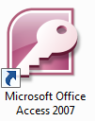


14.1.2 Examples of Database Management Systems
A Database Management System (DBMS) is a software program used to create and manage a database.
It provides users with tools used to add, delete, access, modify, and analyze data stored in one location.
Examples of DBMS software include: Microsoft Office Access, dBase, SQL Server, Oracle, MySQL, Informix, DB2, Paradox, FoxBase, FileMaker Pro, Lotus Approach, etc.

Slide 14
14.1.3 Features of Database Management Systems
DBMS typically have the following features:
Logical Data structures / Objects – such as tables, forms, queries and reports, used to store and manipulate structured data.
A query language (such as SQL) used to manipulate or extract data.
Filter Commands- that display data which satisfy certain conditions.
Data validation commands: that ensure the integrity of data entered and stored in the database.

Slide 15
14.1.3 Features of Database Management Systems
Relationships/associations between data objects/ tables.
Sort commands/tools that arrange data values in a certain order.
Import/Export commands to enable sharing of data between the database program and other programs that use similar structured data.
Built-in functions (similar to those available in spreadsheet applications) that simply calculations.

Slide 16
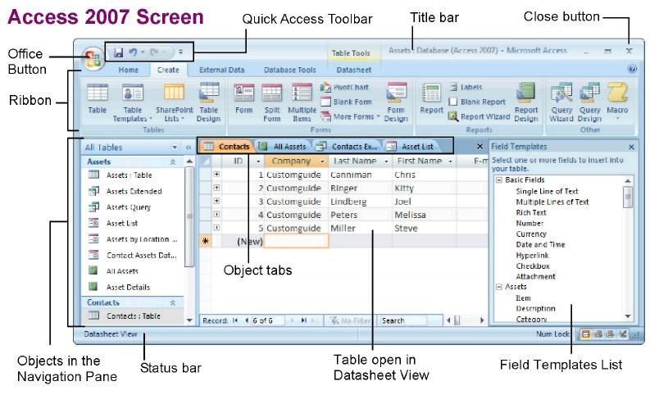
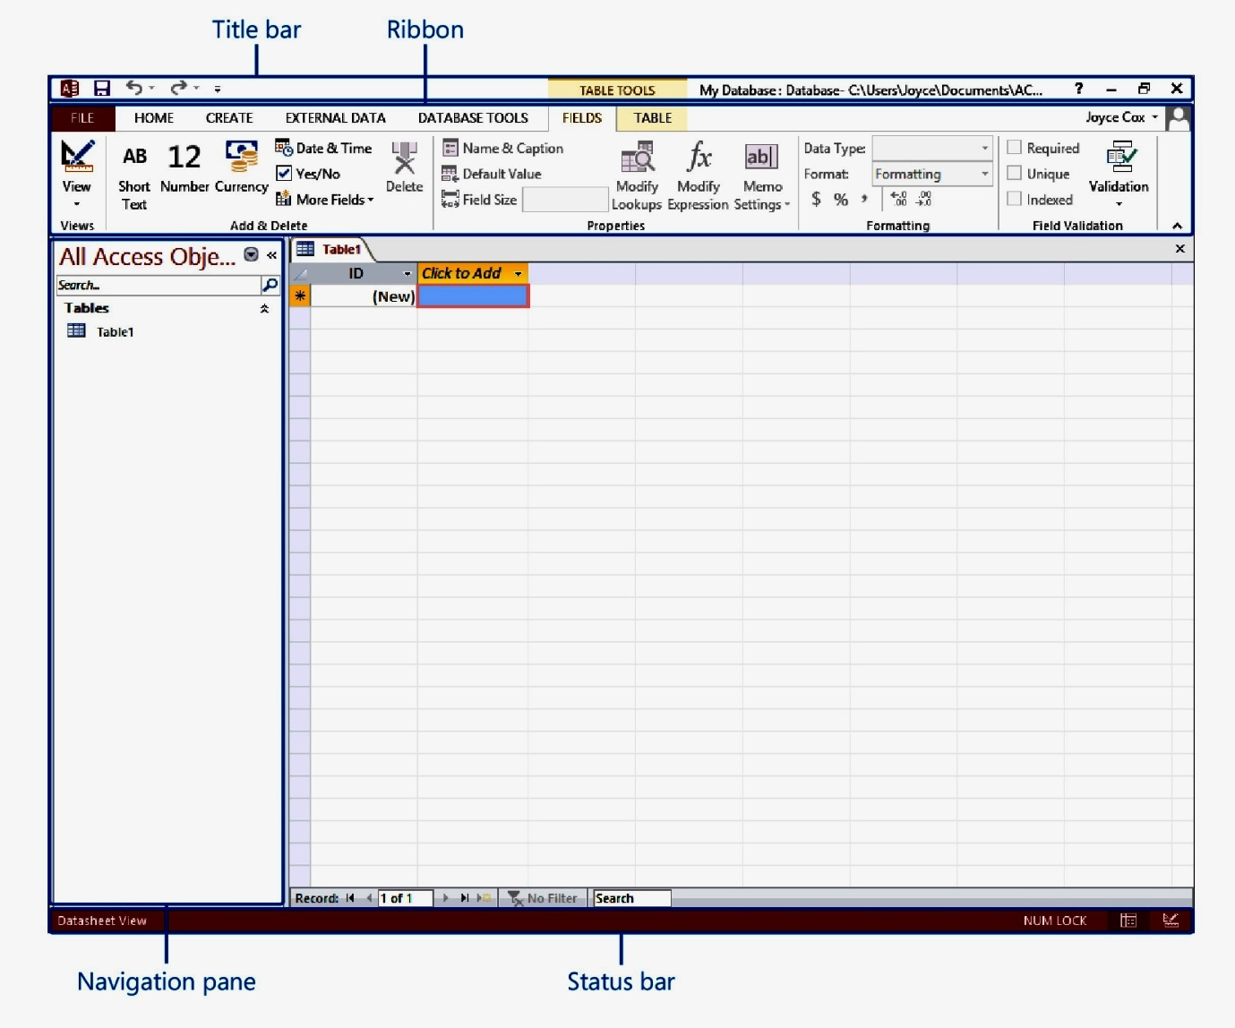
14.1.3 Features of Database Management Systems
Microsoft Access user interface elements: When you start Microsoft Access, the program interface has a number of elements as labelled below.
Access 2013 Access interface

Slide 17
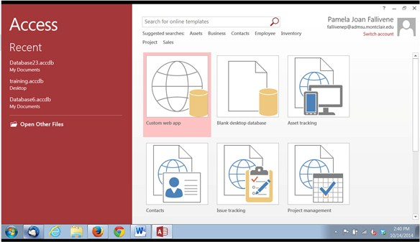
14.1.4 Creating and saving a database
To open Microsoft Access, Open the Start menu and select Programs/ All Programs, Microsoft Office and Microsoft Access). Alternatively, you can use a Desktop shortcut if it exits.
To Create a Database, click on Blank desktop database button shown below.

Slide 18
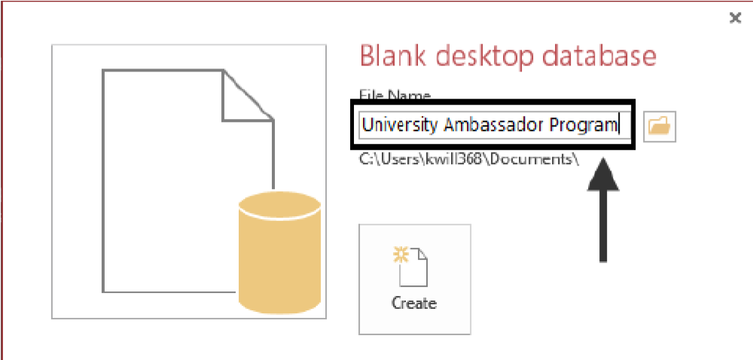
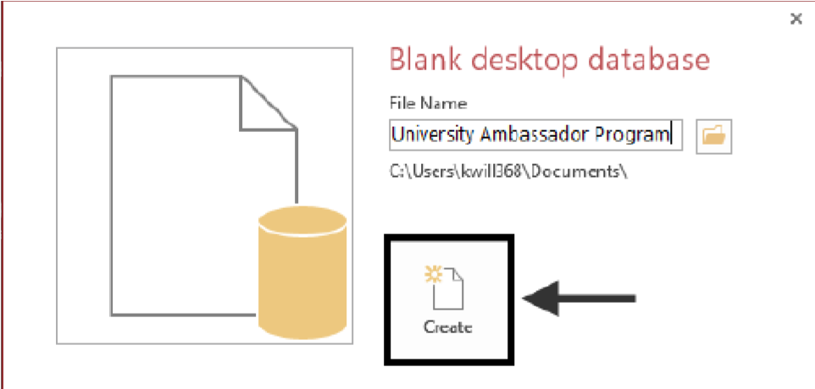
14.1.4 Creating and saving a database
Browse to a location on the computer where you wish to save the database file, and enter the name of the database in the File Name text box.
NB: The file extensions for a Microsoft Access Database is .accdb (for 2007 and above) or .mdb for Access 2003 format.
Click on the Create button. You will be taken to your new database ready for you to start creating tables, forms and other objects.

Slide 19
Sub Topic 14.2: Database Objects
Sub topic Objectives:
14.2.1 Tables
Creating a table in a database
Modifying a table
Saving, editing and deleting tables
14.2.2 Forms
Creating Forms
Data entry and modification using forms
Form Header/Footers
14.2.3 Queries
Generating and Saving Queries
Query Criteria and Calculations in queries
14.2.4 Database Objects: Reports
Creating database reports
Modifying database reports
Printing options

Slide 20
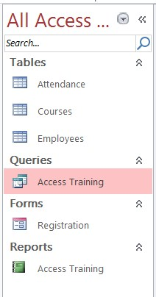
Sub Topic 14.2: Database Objects
Ms. Access allows you to manage your information in one database file. However, within Access, there are many objects, the major objects being: Tables, Queries, Forms and Reports.
Tables store your data in your database.
Forms allow you to enter and view data stored in your tables.
Queries ask questions about information stored in your tables.
Reports allow you to print data based on queries/tables that you have created.
The Navigation Pane is a list containing every object in your database. For easier viewing, the objects are organized into groups by type. You can open, rename, and delete objects using the Navigation Pane.
To Minimize and Maximize the Navigation Pane, Click the double arrow in the upper-right corner of the Navigation Pane to minimize and maximize.

Slide 21
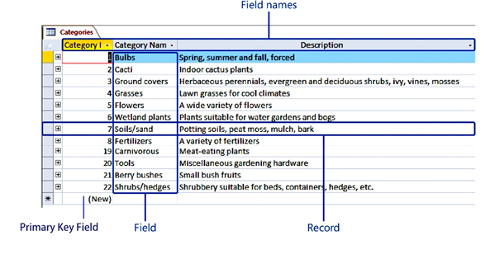
14.2.1 Tables
Tables are database objects which store related data in rows (records) and columns (fields). Below is an Access table in datasheet view.

Slide 22
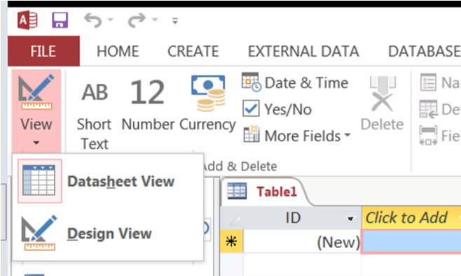
14.2.1 Tables
To Create a New Table: Click the Create tab on the Ribbon and click a button for the Table.
For tables, the two most common views are Datasheet view, in which you can display and modify the table’s data, and Design view, in which you can display and modify the table’s structure.
To open a table in Datasheet view, either double-click its name in the Navigation pane, or right-click its name and then click Open.
To open a table in Design view, right-click its name and then click Design View. When a table is open in Datasheet view, clicking the View button in the Views group on the Home tab switches to Design view; when it is open in Design view, clicking the button switches to Datasheet view.
You can also switch the view by clicking one of the buttons on the View Shortcuts toolbar in the lower-right corner of the program window.

Slide 23
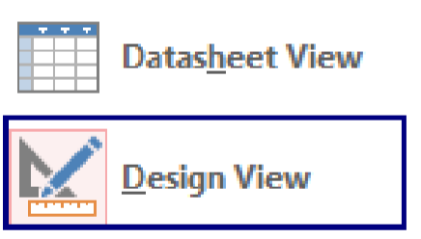
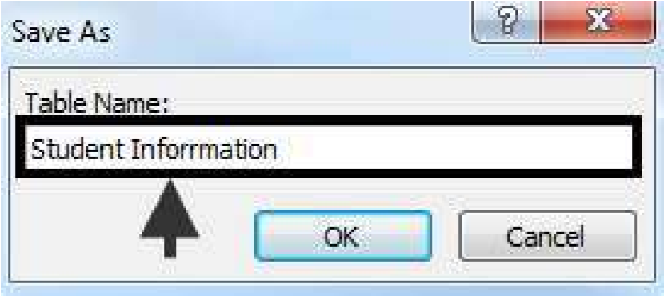
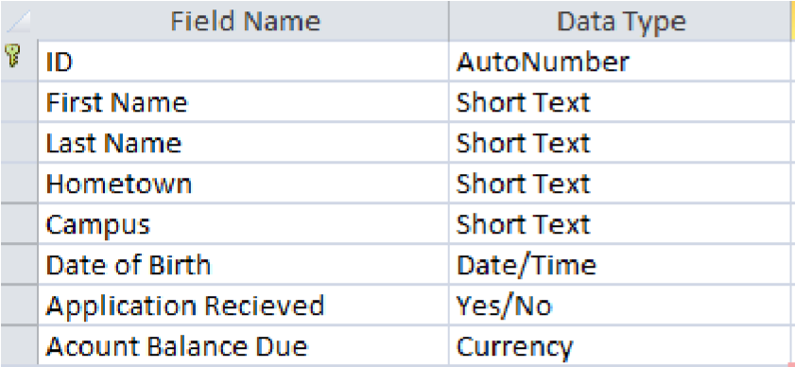
14.2.1 Tables
It is advisable to first create a table using Design View. When you switch the view for first time, you will be promoted to Enter the name of the table that you are about to create in the Save As dialogue box .
In design view, you Enter the Field Names and choose their Data Types

Slide 24
14.2.1 Tables
The following list explains the different data types that could be used for the table:
AutoNumber – The database will create a unique number for each record that is entered.
Short Text – Use for fields that contain letters and numbers. This option can contain up to 255 characters.
Long Text – Use for fields requiring long entries. Both letters and numbers can be created in this field. This option can hold up to 65,536 characters.
Number – Define the field as this choice when calculable numbers will be required for the field.
Date/Time – Select this choice when you need to enter a date or time.
Currency – This option is chosen when dollars and cents need to be entered into the field.
Yes/No – This appears as a check-mark box. Use this choice when the field requires a yes or no entry.
OLE Object – When this is selected, the field can contain a picture or sound clip.
Hyperlink – Use when an email addresses and hyperlinks are required.
Attachment – This option allows the user to attach one or more pictures to the record.
Lookup – This option helps the user create a drop-down list for the field. When this option is selected, the Lookup Wizard will begin.

Slide 25
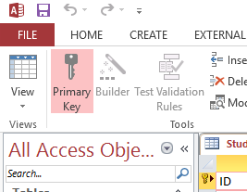
14.2.1 Tables
When designing a table, you have to identify one of the fields to act as a primary key, you set it using the Key button under Design Tab
Primary Key: a field having values that uniquely identify each record in a table. Such a field must not have repeated or missing values.

Slide 26
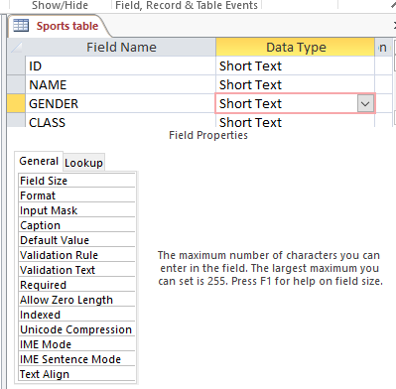
14.2.1 Tables
Field Properties
The Lower part of the table design view displays field properties, which are used to make additional settings for a given data type. The properties of a field change according to the data type.
When you click on a field property such ad Field Size, its description is displayed on the right.

Slide 27
14.2.1 Tables
Field Properties
Field Size - The value of this property determines the maximum number of characters that can be typed in a text field.
Format – This is used to set the layout of data in a field such as the Date/Time and Number fields. E.g the Format dd-mmm-yyyy sets dates to appear in the format 02-Jun-2014, the format yy,mm-d sets the date to appear in the format 14,06-2, etc, while the format ‘UGX’ 0 sets a currency field to display values with a symbol, eg UGX 555. The 0 in the format acts as the placeholder for the values.
Input Masks - Input masks control how users enter data into a database. For example, an input mask like (000) 000-000000 can force users to enter telephone numbers in the Ugandan format ie (256)772-123456. NB: A 0 in an input mask acts as a placeholder for a mandatory single digit. Users must enter a single digit in that position.
Validation Rule - is used to check the value entered into a field as the user leaves the field. Only data that obeys this rule is a valid entry for this field. E.G The rule "F" Or "M“ in the sex field accepts F or M and rejects anything else entered.

Slide 28
14.2.1 Tables
Field Properties
Validation Text - This is the text message that you wish to display to the user if the validation rule is violated.
Default Value - Specifies a String value that is automatically entered in a field when a new record is created. When users add a record to the table, they can either accept this default value or enter another value.
Required - You can use the Required property to specify whether a value is required in a field. If this property is set to Yes, you must enter a value in the field, and the value cannot be Null or blank.
Indexed - You can use the Indexed property to set a single-field index. An index speeds up queries on the indexed fields as well as sorting and grouping operations.

Slide 29
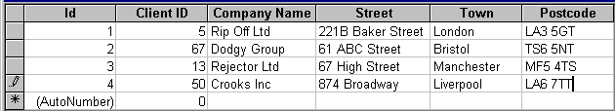
14.2.1 Tables
Adding New Records to your Tables
Once the table structure has been designed and saved, users can then enter data into the table either in the Datasheet View or through a Form.
To Enter Data in the Datasheet View
Type the data into the record.
A pencil indicator displays to the left of the record.
Use [Tab] or [enter] keys to move from field to field and [Shift]+[Tab] to move to previous fields.
Press [enter] at the end of the record. The pencil indicator disappears indicating that the record is now saved. When data is entered in the datasheet view, it is saved automatically.

Slide 30
14.2.1 Tables
Activity:
The table below shows records extracted from of Uganda Telecom company database.
Using any database management software, create a database and save it as UTL_your name e,g UTL_Okello (01 mark)
Design a table to capture the given data using appropriate data types. Set one of the fields as a suitable primary key and save the table as Customer details. (05 marks)
NAME | SEX | TEL NUMBER | SMART PHONE | AIRTIME | MOBIILE MONEY BALANCE | Date Registered
ZIMWE HENRY | M | 0712568777 | NOKIA 3012 | 4000 | 5000 | 1-June-01
ABBO TEO | F | 0712218746 | SONY 1O1 | 3500 | 7700 | 12-Jan-05
NAISANGA ROSE | F | 0712433256 | NOKIA F6 | 500 | 4200 | 17-Dec-02
MUGISHA JOSEPH | M | 0712444508 | SAMSUNG GALAXY S8 | 1200 | 6900 | 23-Sep-11

Slide 31
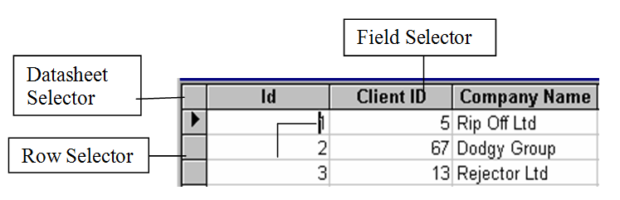
14.2.1 Tables
Selecting Fields & Records in Datasheet View. In order to edit (or sort) table data it is necessary to select fields and records.
Sorting data in Access Tables: In Access there are a couple of ways to sort data in ascending or descending order. What we sort in Access are fields. You can sort by one field or by many fields, but the fields must be adjacent. Note that if you sort by multiple fields, Access will sort data from left to right i.e. it will sort by whichever field is furthest from left and move right.

Slide 32
14.2.1 Tables
Sorting by one field(Quick Sort)
To sort by one field:
Place the cursor anywhere in the column on which you want the sort performed.
Open the Records menu, select Sort and choose Sort Ascending, or Sort Descending on the submenu. You can also click the quick sort buttons( )on the database toolbar. Access sorts the table based upon the data in the selected column.
To undo the sort, Open the Records menu and select Remove Filter/Sort.

Slide 33
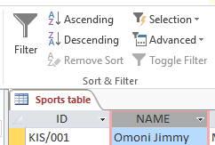
14.2.1 Tables
Sorting by multiple fields
To sort across multiple fields, do the following:
Select multiple columns by clicking and dragging across the column headings of the column you want to sort.
On the Records menu, select Sort, and then choose Sort Ascending or Sort Descending. You can also click the quick sort buttons on the database toolbar.
Access sorts by the leftmost column first, then performs secondary sorts ( where there are duplicate values) on the remaining selected columns to the right.

Slide 34
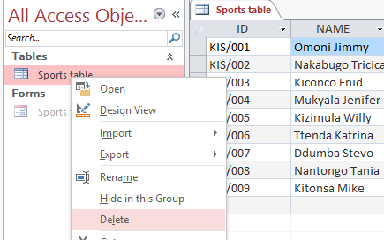
14.2.1 Tables
Editing and deleting tables and other objects
To Modify an Object: Open the object or click its tab in the window, click the Format tab on the Ribbon, click the View button in the Views group and select Design View or Layout View.
To Delete an Object: Select the object and press <Delete>. Click Yes.
To Rename an Object: Right-click the object, select Rename from the contextual menu, enter the new name, and press <Enter>.

Slide 35
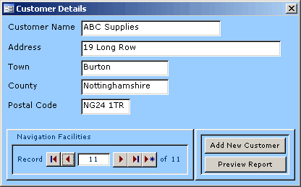
14.2.2 Forms
A form is a database object that you can use to enter, edit, or display data from a table or a query. You can use forms to control access to data, such as which fields or rows of data are displayed.
For example, certain users might need to see only a few fields in a table with many fields. Providing those users with a form that contains just those fields makes it easier for them to use the database. You can also add buttons and other functionality to a form to automate frequently performed actions.
Think of forms as windows through which people see and reach your database. An effective form speeds the use of your database, because people don't have to search for what they need. A visually attractive form makes working with the database more pleasant and more efficient, and it can also help prevent incorrect data from being entered.

Slide 36

14.2.2 Forms
Create a form by using the Form tool
You can use the Form tool to create a form with a single mouse-click. When you use this tool, all the fields from the underlying data source are placed on the form. You can begin using the new form immediately, or you can modify it in Layout view or Design view to better suit your needs.
In the Navigation Pane, click the table or query that contains the data you want to see on your form.
On the Create tab, in the Forms group, click Form.
Access creates the form and displays it in Layout view. In Layout view, you can make design changes to the form while it is displaying data. For example, you can adjust the size of the text boxes to fit the data, if necessary.

Slide 37
Sub Topic 3: Practical Database Project
Sub topic Objectives:
14.3.1 General Steps of developing a database
14.3.2 Project: School Students Registration / marks / reports database management system
Create a sample school database
Create related students and results tables
Create mark entry forms
Generate queries for results, totals, age and average
Design summative students’ reports.

Slide 38
14.3.1 General Steps of developing a database
Establish the purpose/objectives of creating the database.
Starting with the database as a whole, identify the data objects (commonly known as tables) that will be part of your database. The purpose of the database determines the number of tables in your database and their relationships.
Design each table as follows:
For each table, specify the attributes or fields. Field names serve as column headings in your tables. Note that each field will have values of a specific data type e.g. numbers, dates, text etc.
Identify one or more fields having unique values (e.g. indexNumbers, NSSF numbers etc). A unique field will serve as the primary key of the table.

Slide 39
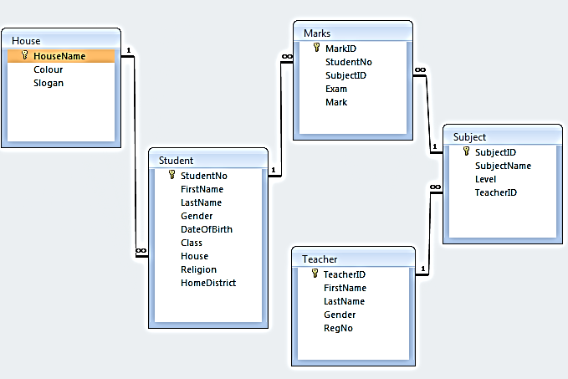
14.3.1 General Steps of developing a database
Identify fields that are shared between tables and create relationships between the tables.
Sample Database Structure/Schema for a School Database

Slide 40
14.3.1 General Steps of developing a database
Refine your database design by removing or adding more fields. When the design of the database structure has been completed, you can now choose a DBMS to use.
Use your DBMS such as Microsoft Access to create your electronic database and enter some data into the tables of the database.
Thereafter, the data can be retrieved and manipulated in various ways by database objects, such as queries, forms and reports, or other computer programs.

Slide 41
14.3.2 Project: School Students Registration / marks / reports database
Create a sample school database
Create related students and results tables
Create mark entry forms
Generate queries for results, totals, age and average
Design summative students’ reports.

Slide 42
Subsidiary ICT for Uganda
End of Topic
14: Databases
Next Topic 15: System Security, ICT Ethical Issues and Emerging Technologies

